Slide 1
Lecture 2
AI Techniques
AI in last century
The Turing test

Slide 2
AI Techniques
In most cases, the AI problems have no algorithm.
In many other cases, the process has simple algorithm but with many permutations and combinations.
In many other cases, we do not want best answers but answers which are acceptable.
Conventional programs do not usually have learning component.
Another important requirement of many AI program is called explanation facility.
Artificial intelligence problems span a very broad spectrum.
They appear to have very little in common except that they are hard.

Slide 3
Are there any techniques that are appropriate for the solution of a variety of these problems?
The answer to this question is yes, there are.
One of the few hard and fast results to come out of the first three decades of AI research is that intelligence requires knowledge.
To compensate for its one overpowering asset, indispensability, knowledge possesses some less desirable properties, including:
It is voluminous.
It is hard to characterize accurately.
It is constantly changing.
It differs from data by being organized in a way that corresponds to the ways it will be used.

Slide 4
An Al technique is a method that exploits knowledge that should be represented in such a way that:
The knowledge captures generalizations. In other words, it is not necessary to represent separately each individual situation. Instead, situations that share important properties are grouped together. If knowledge does not have this property, inordinate amounts of memory and updating will be required. So we usually call something without this property "data" rather than knowledge.
It can be understood by people who must provide it. Although for many programs, the bulk of the data can be acquired automatically (for example, by taking readings from a variety of instruments), in many Al domains, most of the knowledge a program must ultimately be provided by people in terms they understand.
It can easily be modified to correct errors and to reflect changes in the world and in our world view.

Slide 5
It can be used in a great many situations even if it is not totally accurate or complete.
It can be used to help overcome its own sheer bulk by helping to narrow the range of possibilities that must usually be considered.

Slide 6
AI in last century
The name Artificial Intelligence is credited to John McCarthy with Marvin Minsky and Claude Shannon ( 1916-2001), who organized Dartmouth conference in 1956.
Take up action in 1950 when Alan Turing proposed Imitation Game – Turing test
Claude Shannon published paper on Chess playing programs.
After that checkers playing program appeared, first being written in 1951 by Christopher Strachey at Uni. Of Manchester
The program by Arthur Samuel became popular( 1956 – Darmouth Conf.) (Checkers) .
The first program with learning and evaluation function for evaluation of moves
The person credited for Alpha – Beta Pruning - method to cut down search efforts Alex Bernstein developed first chess playing program in 1957.

Slide 7
David Levy won competition by beating Chess4.7– 1968
He was defeated by Deep Thought from CM University later in 1989.
Deep Blue from IBM beat Gary Kasparov in 1997.
In 1963, Natural language parser developed by Susumu Kuno
In 1956, Herbert Simon and Alan Newell demonstrated a working theorem prover called LT ( Logic Theorist ) with J C Shaw.
In 1961, James Slage wrote first symbolic integration program SAINT, which formed base for many symbolic mathematics tools
The significant contribution by Newell and Simon was GPS – General Problem Solver – addressing general purpose problem solving based on human thought process.
GPS first implanted in OPS5 – language for building expert systems

Slide 8
John Laird and Paul Rosenbloom built general symbol problem solving architecture called SOAR.
Concept of neural networks and neurons and weights with process of training
The first system of such kind was called Perceptron built in 1957 by Frank Rosenblatt.
Mid eighties - Back propagation algorithm for training multi layer neural network.
John McCarthy invented Lisp, the programming language for AI practitioners
In 1965, Alan Robinson published Resolution Method for theorem proving that brought all kinds of logical inferences in to one uniform fold.

Slide 9
Robert Kowalski and Alain Colmerauer created Prolog in 1972.
The first autonomous robot was built by John Hopkins University in early sixties. (Hopkins Beast)
It was battery driven and goal was to keep its batteries charged
The first robot doing something was built at Stanford Research Institute in 1966 (Shakey).
The first planning system STRIPS developed in 1971 by Richard Fikes and Nils Nillson.
System that created impression in 1970 was Terry Winograd’s natural language understanding system – SHRDLU
Winograd’s office mate and a student – Eugene Cherniak from MIT made observation that the real task behind understanding language lies in knowledge representation and reasoning.

Slide 10
Another view was expressed by Yale University students and Roger Schank .
They did a considerable work, hand coding knowledge into complex systems that could read stories and answer questions about them in intelligent fashion .
In 1980s, Michael Dyer written the program BORIS.
Knowledge representation with different methods like frames, rules and semantic nets.
The importance of knowledge is illustrated by Dendral , a program developed at Stanford University in 1967.
Program was designed as chemist’s assistant to identify structure of molecule.
Rule based expert systems came in to know.

Slide 11
In early 70s, MYCIN was developed by Edward Shortliffe.
Another medical system was Internist developed at University of Pittsburgh.
Prospector was developed to help geologists to prospects of minerals.
The major problem in expert system design was to acquire domain knowledge from experts.
NASA deployed AI tech. in deep space.
The last frontier is machine learning.

Slide 12
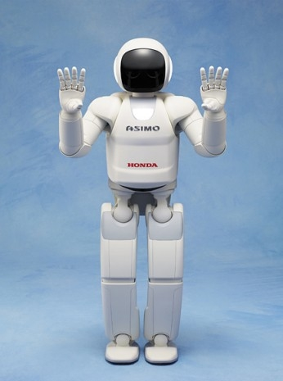
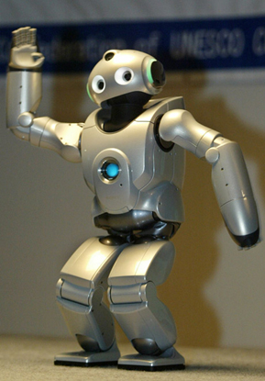
Asimo and Qrio

Slide 13
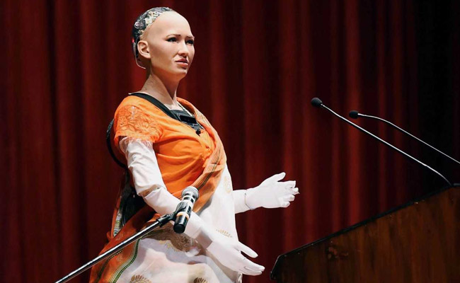
Sophia

Slide 14
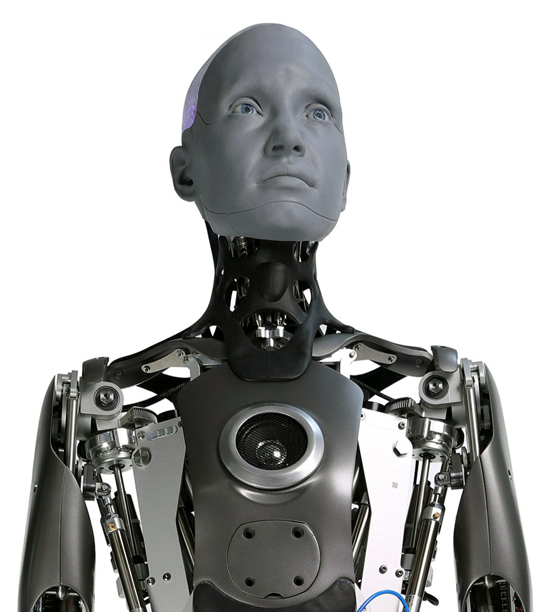
Ameca

Slide 15
https://www.youtube.com/watch?v=qir5SkmaiQM
https://www.youtube.com/watch?v=Ub1Z02dVKXM
https://www.youtube.com/watch?v=3aZ3_ppQoZ8
https://www.youtube.com/watch?v=LzBUm31Vn3k
https://www.youtube.com/watch?v=IaagU94RFNw
https://www.youtube.com/watch?v=mNWpw_AeFVc

Slide 16
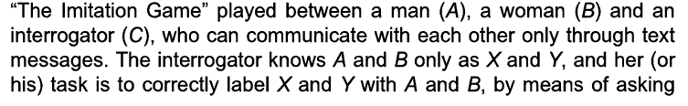
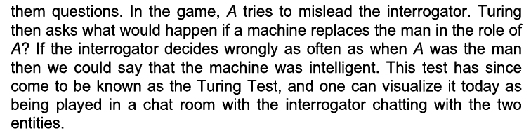
The Turing Test
Alan Turing, prescribed a test to determine whether a machine is intelligent (1950).
He proposed “The Imitation game” played between a man (A), a woman (B) and an interrogator (C) .

Slide 17
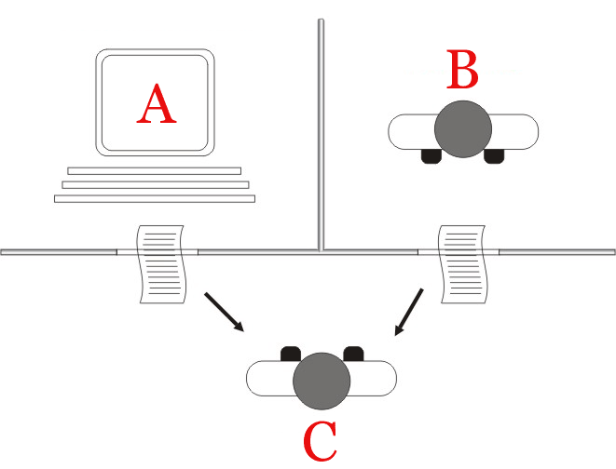
The "standard interpretation" of the Turing test, in which player C, the interrogator, is given the task of trying to determine which player – A or B – is a computer and which is a human. The interrogator is limited to using the responses to written questions to make the determination.

Slide 18
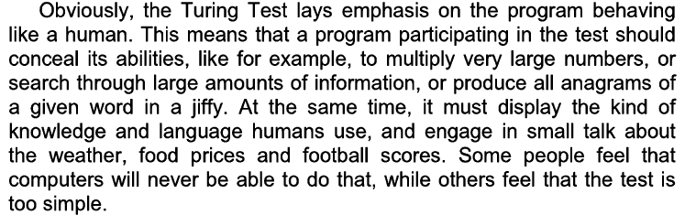
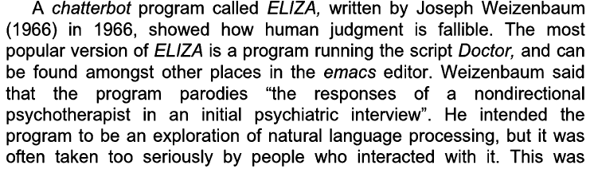

Slide 19
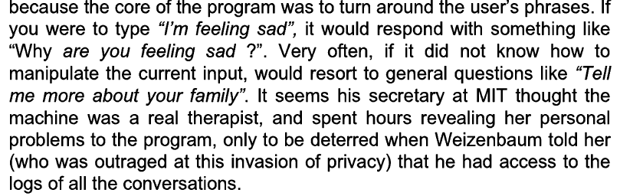
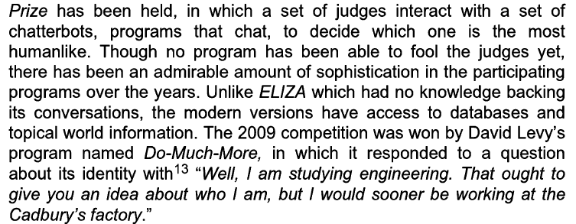

Slide 20
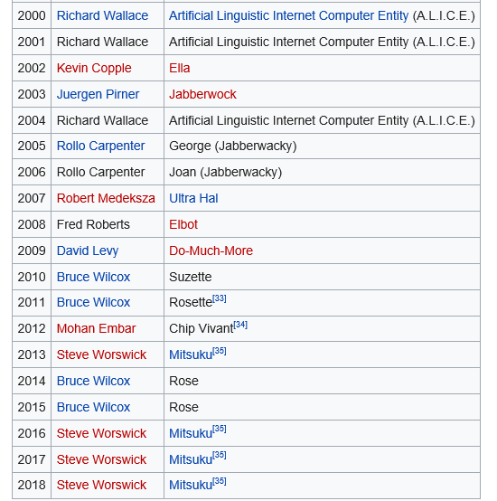
Loebner prize winners

